Slide 1
GeoXO Program Update
Craig Keeler
March 16, 2023

Slide 2
GeoXO Introduction
GeoXO = Geostationary Extended Observations
Satellite series to follow GOES-R, providing continuity for geostationary environmental observations
Continues and improves observations for weather forecasting
Extends observations to ocean and atmospheric monitoring
Provides environmental data broadcast via commercial satellite services
NOAA-NASA Partnership
Series of six satellites, operated in a constellation of three:
East + West locations: Imager, Lightning Mapper, Ocean Color
Center location: IR Sounder, Atmospheric Composition
Timeline:
Formal GeoXO Program approval Nov 2021
Milestone 2 Approval Dec 2022
Imager Contract Award Mar 2023
1st GeoXO Launch 2032
Operational life of series 2032-2055

Slide 3
GeoXO Constellation
HRIT/EMWIN and GRB Direct Broadcast via Commercial Satellite Services
DCS data relay and 2-way commanding planned for GOES-East and West S/C

Slide 4
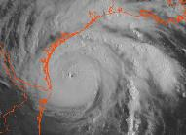
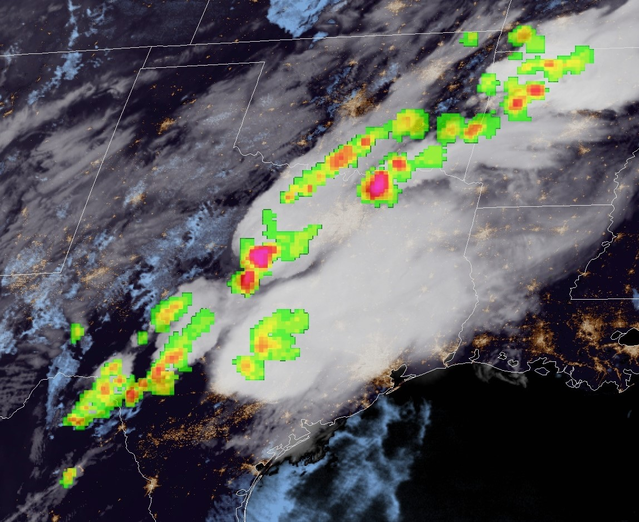
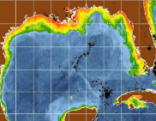
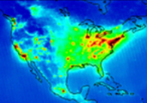
Evolution of GOES-R to GeoXO
GOES-R provides Visible/Infrared Imagery and Lightning data:
Essential for short-range forecasting, issuing severe weather watches and warnings, and monitoring hazardous environmental conditions including tropical storms, severe storms, damaging winds, snow, ice, flooding, fog, fires, smoke, and volcanic ash
GeoXO will continue and improve Imagery and Lightning data and add new observations:
Hyperspectral IR Sounder for numerical weather prediction and local nowcasting
Ocean Color Instrument for monitoring dynamic coast/ocean features, ecosystem change, water quality, and hazards
Atmospheric Composition Instrument for monitoring air quality and the linkage between air quality, weather, and climate
Vis/Near-IR Imagery
Lightning Mapping
IR Sounding
Ocean Color
Atmo. Composition

Slide 5
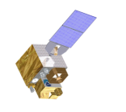
GeoXO Data Delivery Concept
GOES-R provided multiple communication relay services:
Data Collection System (DCS) relay and dissemination plus commanding
GOES-R Rebroadcast (GRB)
High Rate Information Transmission / Emergency Managers Weather Info Network (HRIT/EMWIN)
Search and Rescue (SAR) relay
GeoXO will continue these services, but most are via alternate delivery methods:
DCPR relay and dissemination; DCPC commanding
GRB broadcast via Cloud and commercial communications satellite (“high rate” service)
HRIT/EMWIN broadcast via Cloud and commercial communications satellite (“low/med rate” service)
SAR function performed via GPS constellation
GOES-R
GeoXO
Commsat
DCPC
DCPR
Low/Med
Rate
High
Rate
GRB
HRIT/
EMWIN
SAR
DCPC
DCPR

Slide 6
GeoXO Data Distribution

Slide 7
GeoXO Timeline
GeoXO requirements defined and Program funded to proceed
Phase A studies conducted by potential vendors for preliminary spacecraft design and instrument definition.
NOAA continually assessing user needs and observational capabilities.
In critical design stage, NOAA will provide data to users on new capabilities.
The first GeoXO launch is planned for 2032 to maintain and advance NOAA’s critical geostationary observations through 2055.

Slide 8
For More Information
Please contact Daniel Gillies: Daniel.Gillies@noaa.gov
or Craig Keeler: Craig.a.Keeler@noaa.gov
Or Visit https://www.nesdis.noaa.gov/next-generation-satellites/geostationary-extended-observations-geoxo

